Slide 1
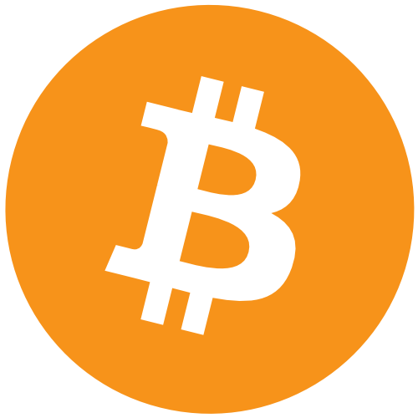
Basic Bitcoin Tech: Connecting a Wallet
Host - Simplest Bitcoin Book w/ Portland.HODL

Slide 2
Overview -
Topics
What is a transaction?
Connecting a wallet your node
Watch Only
Signing a transaction
How to verify a transaction

Slide 3
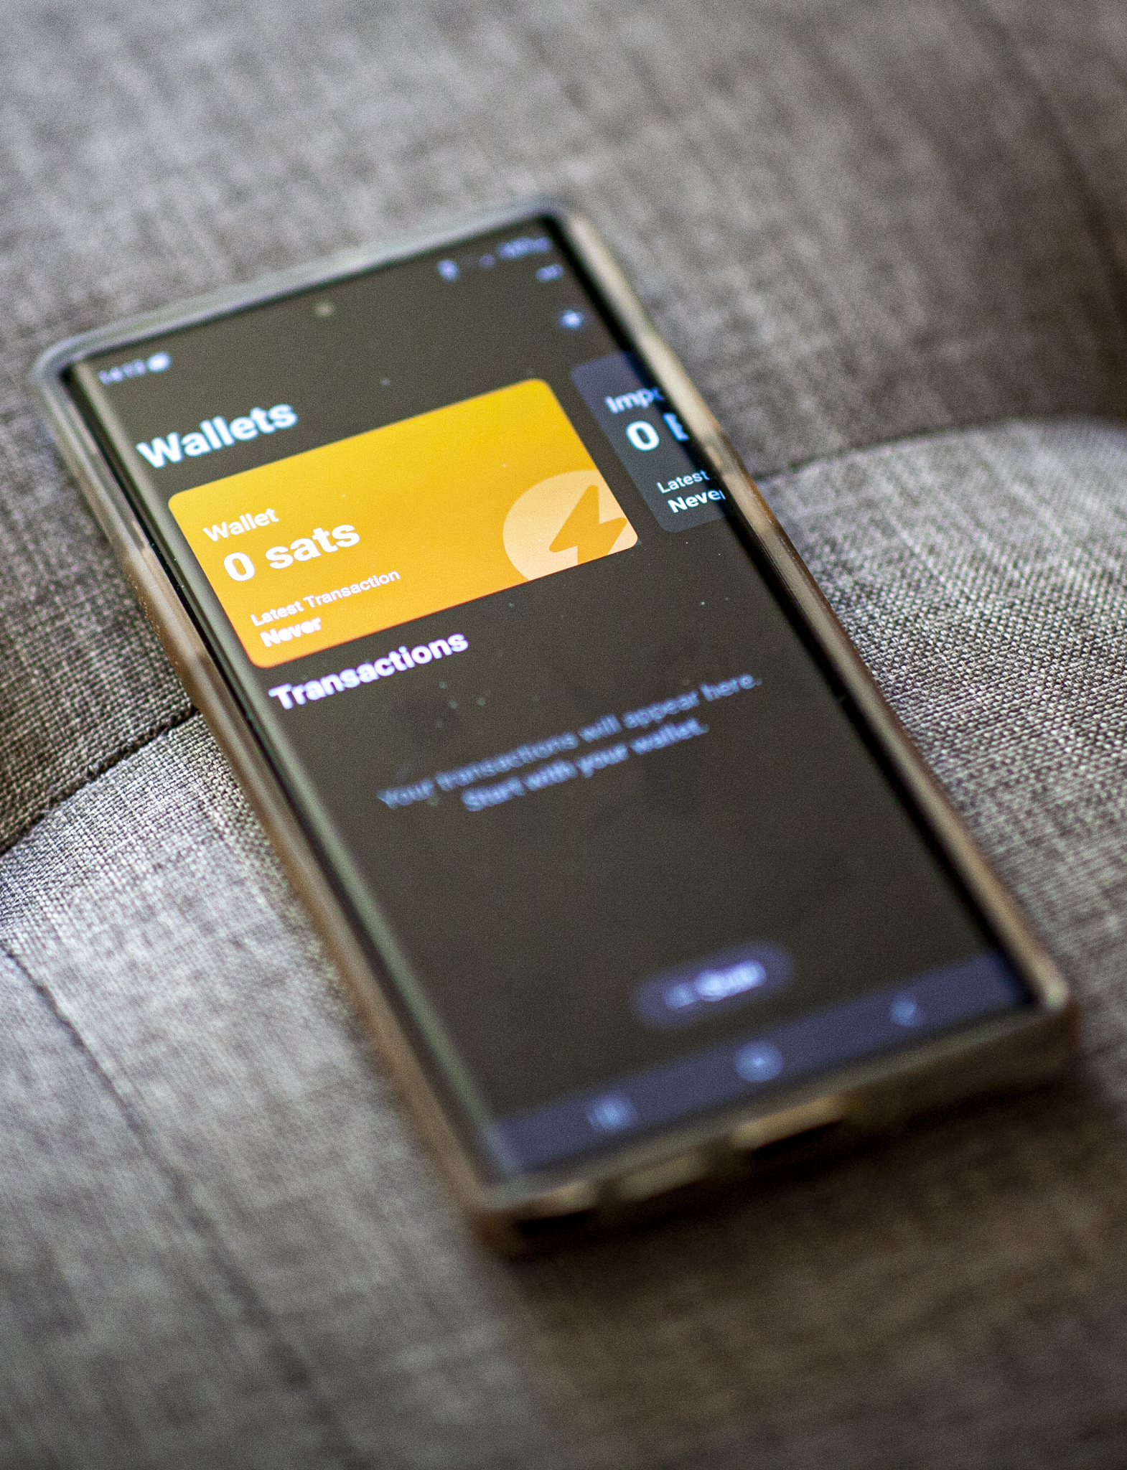
What is a Bitcoin transaction?
Definition
“A transaction is when participant A signs over a designated amount of Bitcoin they own to participant B”
The sender must have all the required signatures to send the funds to the receiver.
Without the signatures the transaction is invalid and funds wont move from one address to another.

Slide 4
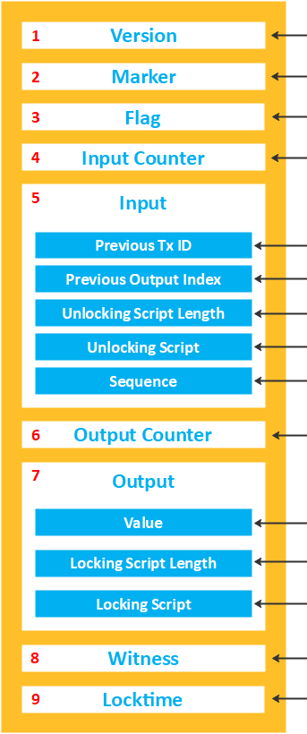
Notes about transactions
Transaction Structure
Transactions move through 3 main stages
Broadcast
Mempool
Mined into a block
Transactions must be properly signed to move bitcoin
Transactions can have multiple senders or receivers (possibly both)
Transactions always have to pay a fee to the miners for their work
The fee is the difference between the input value and the output value
A transaction is comprised of inputs (UTXO’s)
A transaction is data that must be broadcast to the network through a node.

Slide 5
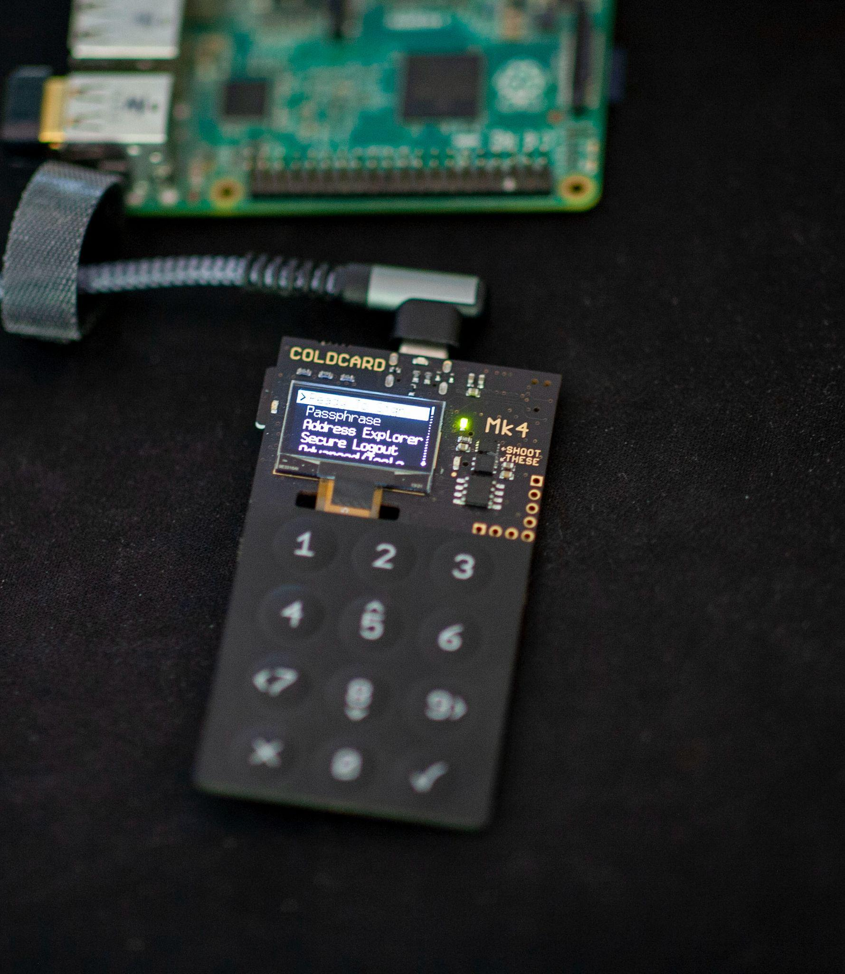
Linking your wallet to your node.
There are 2 primary use cases for connecting your wallet to your node.
Watch only : Keep track of funds and generate new addresses. The private key stays air gapped and funds are not spendable (The XPUB is imported)
Signing : The wallet is connected to the node in such a way funds can be spent (USB, SD-Card, NFC). Some examples of this are Coldcard and Electrum over USB, Ledger Live, and Trezor Suite.

Slide 6
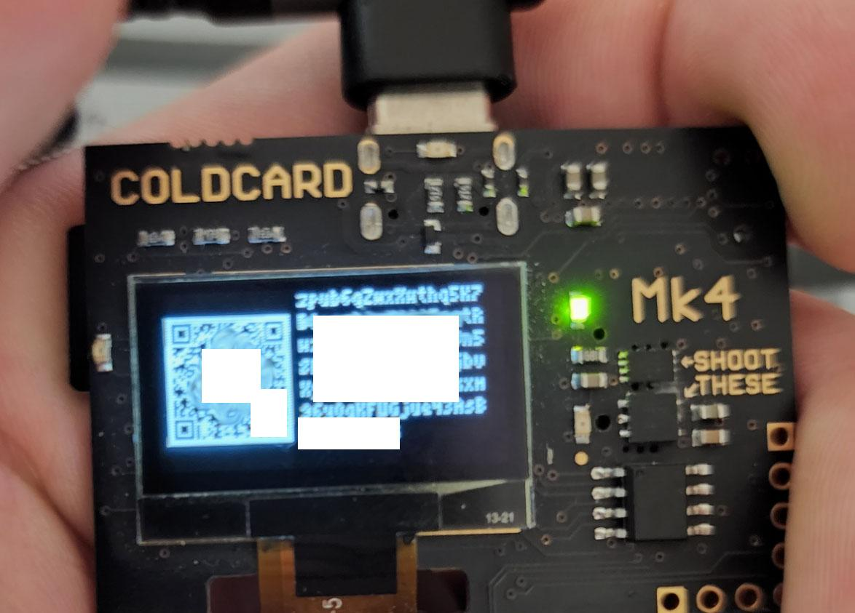
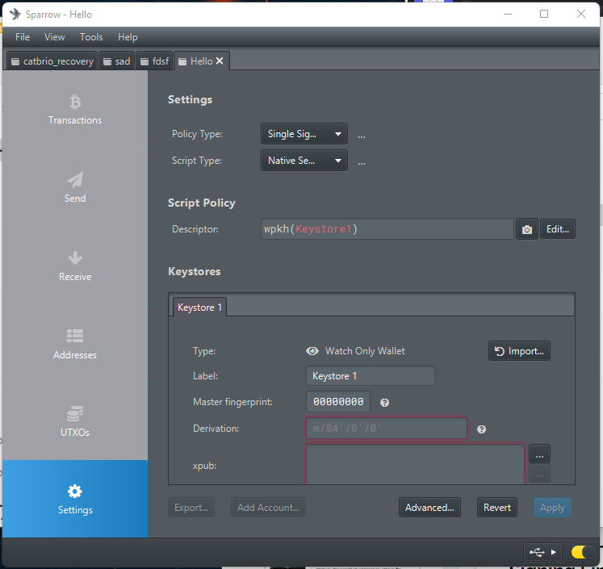
Watch Only Link - No Spending
Cold Card QR (XPUB)
A watch only link is a link to a node where an XPUB (extended public key) or a HD (Hierarchical Descriptor) wallet are imported and the node keeps track of balances and can generate new addresses.
Some wallets accept XPUBs (such as blue wallet and Sparrow) - Others can accept files such a Bitcoin Core and Electrum
Sparrow XPUB Import
One of the biggest advantages to linking your wallet to your node is that you can verify and validate transactions trustlessly. That means you do not need to use a block explorer (someone else's node) to verify that your funds have arrived.
Connected to 3rd Party Node BAD!!!

Slide 7
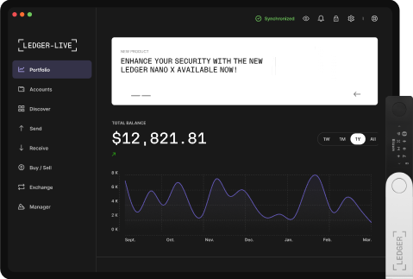
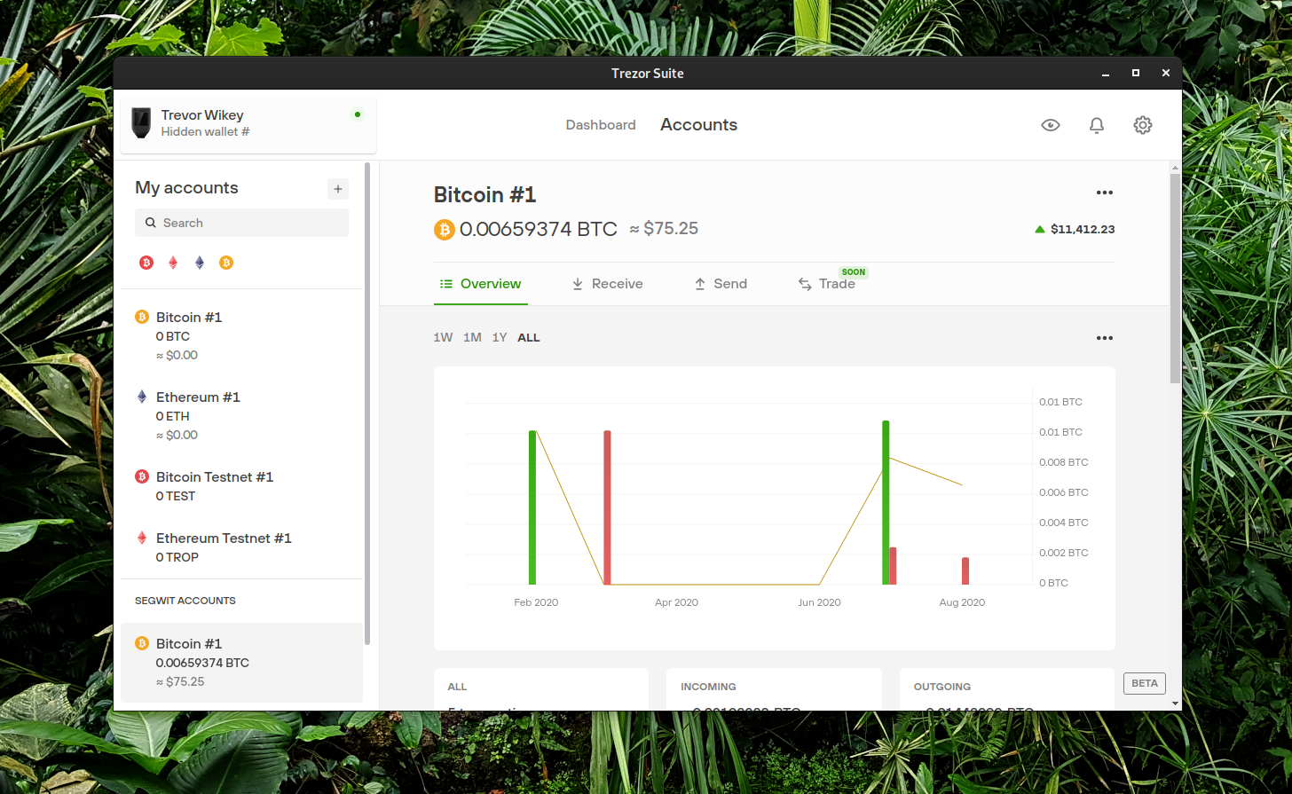
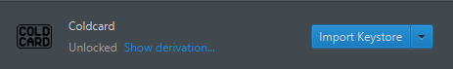
Signing Link - Spendable Transactions
Ledger Live - Can connect to your full node
There are multiple ways to connect a wallet to your node to sign transactions.
Linking over USB
SD Card
Import Seed Phrase (This is creating another wallet)
Important to ensure the wallet software you are using actually connects to your node and not to a third parties’ node.
Breaking the airgap potentially can expose keys if the device is compromised.
Hardware wallet must be ‘unlocked to spend funds’ watch only works all the time.
Trezor Suite Can connect to your full node w/ Electrum Server
Cold Card Needs to use a external software Bitcoin Core or Sparrow Directly.

Slide 8
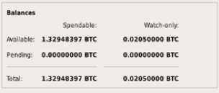
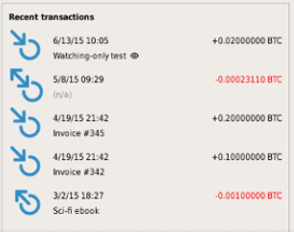
Verifying a transaction!
Verify your funds with your own full node!
Verifying a transaction means that ‘you’ know with full certainty that funds are in your custody or have been received by the other party.
When your XPUB or wallet is connected to your node you can with certainty know that a transaction has settled.
The wallet software will show an up-to-date balance.
If you want to go a step further you can check in the Bitcoin Core command line. ‘gettransaction (txid)’

Slide 9
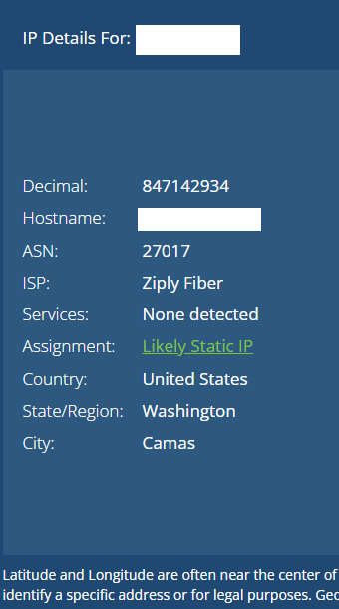
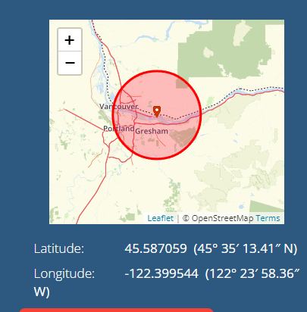
Broadcasting a Transaction (TX)
To spend bitcoin - a signed transaction must make it to the miners.
To do this 99.99999% of people broadcast a transaction to the Bitcoin network with an internet connected computer.
These transactions if they are segwit can’t be manipulated but the act of broadcasting the TX can expose your IP Address if you aren’t using TOR or a VPN & even then this doesn’t ensure perfect privacy.
It does ensure that your IP address isn’t leaked.
If you use a hardware wallet with an SD Card or the ability to export a transaction, you can then go to another computer that wouldn't expose personal information and then broadcast a transaction from that device. E.g. Using a library computer with sparrow wallet.

Slide 10
Thanks For Listening.
Questions or Comments? Please ask to come on stage.
Anything incorrect please comment on the slide in question.

